Slide 1
TMDB Movie data Analysis
Sanket Bhosale

Slide 2
CONTENTS
Introduction
Tasks Perform
Conclusion

Slide 3
INTRODUCTION
Movies that cost over $100 million can `still fail.
Movie lovers might have different interests.
A Production company wants to analyze a movie data set to identify what kind of movies perform well in cinemas, which genres they belong to, and so on. It will help the company predict if a movie will be a commercial success, if the movie will be highly rated etc.
To begin with the management has asked Peter, a Data Analyst, to answer certain questions by carrying out the upcoming tasks.

Slide 4
Tasks performed

Slide 5
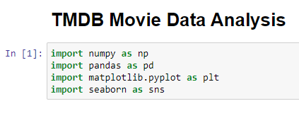
Importing the Libraries and Modules
Before starting the tasks we need to add some Libraries and Modules for performing the tasks.
These libraries help to analyze the data, visualize it, etc.
We added the library/modules listed below:-
NumPy
Pandas
Matplotlib
Pyplot
Seaborn

Slide 6
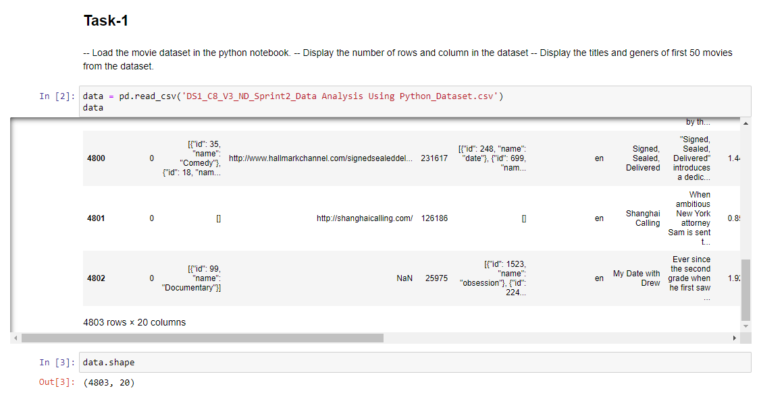
Task-1:-Load the movie dataset in the Python notebook. Display the number of rows and columns in the dataset Display the titles and genres of the first 50 movies from the dataset.
First we are importing the CSV file into the Jupyter Notebook. For importing we use the ‘pd.read_CSV’ command.
After importing, we count the rows and columns of the data frame.
In this data we got a total of 4803 Rows and 20 Columns.

Slide 7
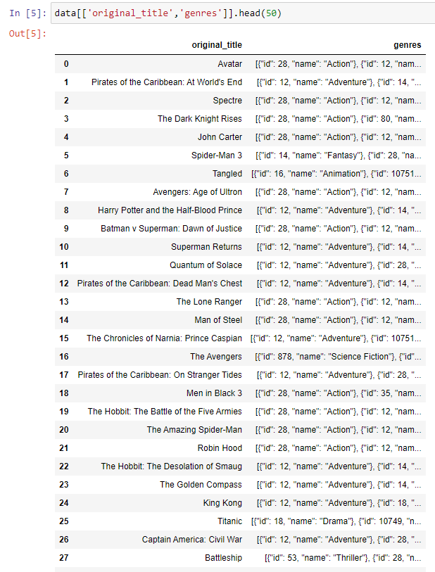
Task-1:-Load the movie dataset in the Python notebook. Display the number of rows and columns in the dataset Display the titles and genres of the first 50 movies from the dataset.
After importing the data, we want to show the first 50 rows of the data
For this, we are using the ‘head()’ command
In the head we need to specify the limit to show the rows. Here we are entered 50.
The Avatar movie is ranked first in the list.

Slide 8
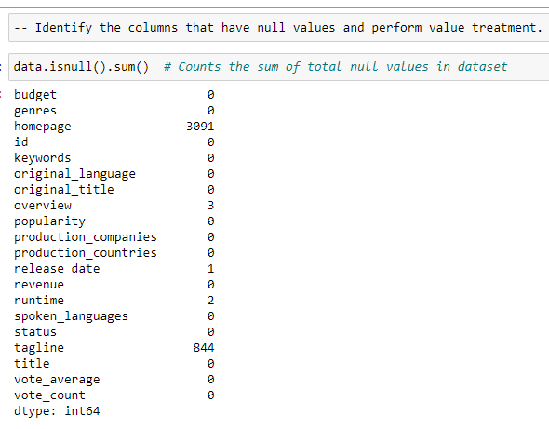
Task-2:-Identify the columns that have null values and perform value treatment.
In this data, we re counting the sum of the null values in the data frame.
We use the isnull() command to find the null values in data set.
We got some null values in the listed columns
Homepage
Overview
Release date
Runtime
Tagline
For this problem we fill the null values by the mode/ mean values.

Slide 9
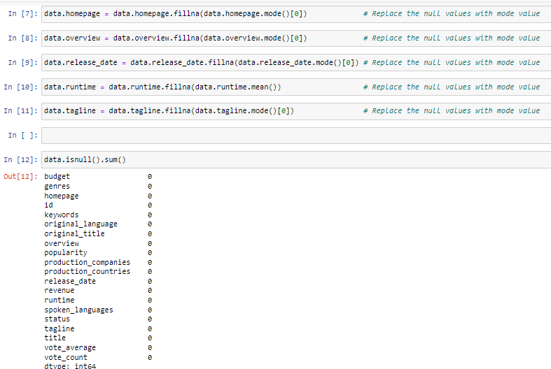
Task-2:-Identify the columns that have null values and perform value treatment.
In this task, we are filling the null values by the mode/mean values.
If the data is in object type then we use the mode values to fill the null values.
If the data is in the int / Float form, we use mean values.
In the mode function we got one or many values, so we use the first appearing value for the process.
After this process we completely replaced all null values and we got the 0 for count of null values.

Slide 10
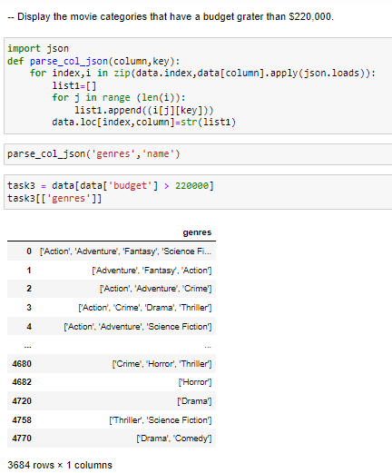
Task-3:-Display the movie categories that have a budget greater than $220,000.
For this task, the data is in json format
First, we need to extract the data for this extracting we define a function for it.
In this function we extract the column
Now we apply the filter for the movie category whose budget is greater than 220000.
We got a total of 3684 rows in output.

Slide 11
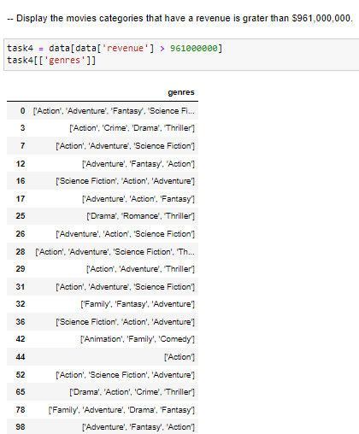
Task-4:-Display the movie categories that have a revenue greater than $961,000,000.
In this task, we filter the dt for the categories whose revenue is greater than 961,000,000.
we got a total of 26 rows in the output.

Slide 12
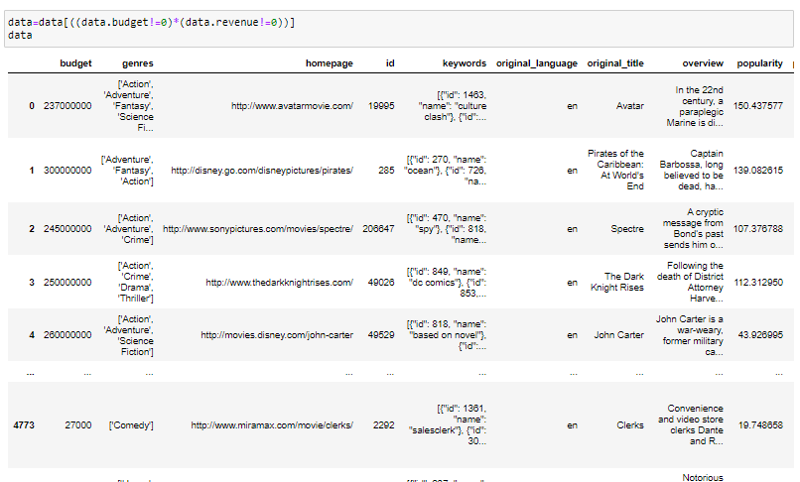
Task-5:-In the dataset, there are some movies for which the budget and revenue columns have the value 0. Which means an unknown value. Remove the row with the value 0 from both the budget and revenue columns..
we deleted the rows whose revenue and budget column contains the 0 value.
We use the filter method to analyze the data
After this process, we got a total of 3229 rows in output.

Slide 13
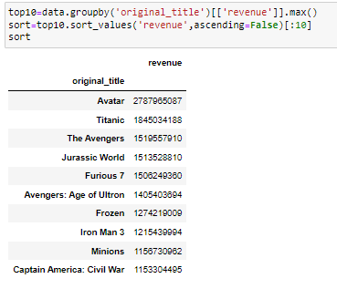
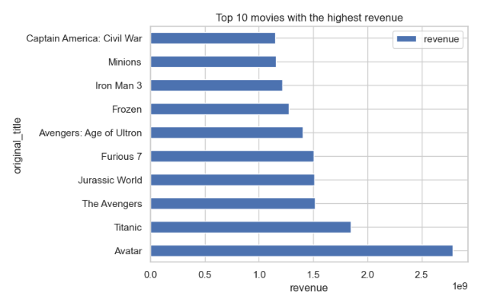
Task-6:-List the top 10 movies with the highest revenue.
In this task, we’re finding the top 10 movies with the highest revenue.
The Avatar movie has the highest revenue generated around 2.7 billion Dollars.
Th Captain America in 10th place which generated around 1.1 billion dollars,

Slide 14
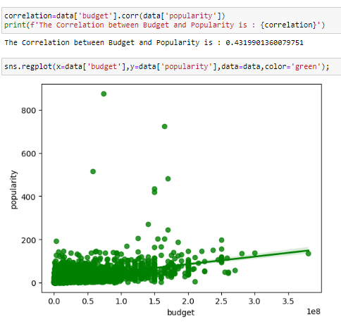
Task-7:- How are populations of movies related to the movie budgets? Are they correlated or totally uncorrelated with each other? Write an interpretation of your analysis
In this task, firstly we calculate the correlation between the budget and popularity
the correlation is 0.43
This is the weak positive correlation between the budget and popularity column.
we are using the scatter plot to visualize the correlation between them.

Slide 15
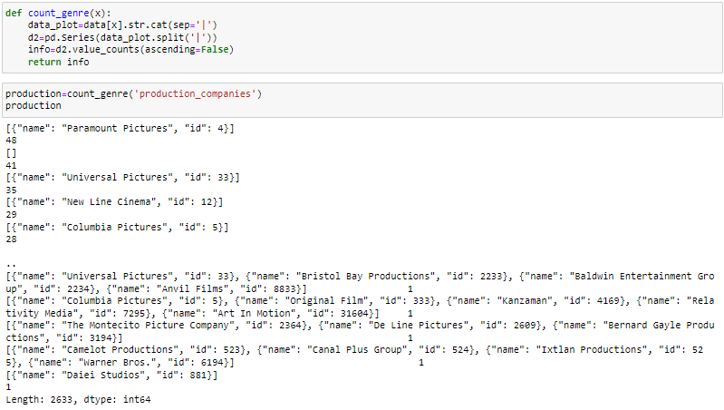
Task-8:- Identify and display the names of all production along with the number of times they appear in the dataset.
In this task, we want to count the numbers of the production that appear in the dataset.
As per output, the paramount production appears more time in the dataset which is 48 times.
There are a total of 2633 rows in output.

Slide 16
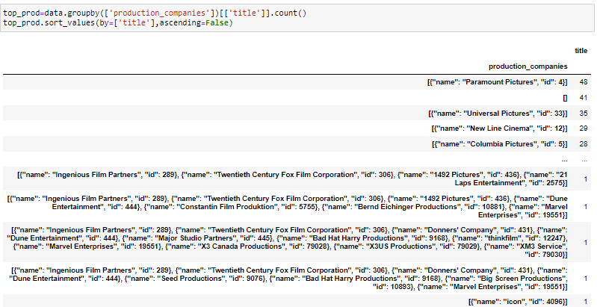
Task-9:- Display the names of the top 25 production companies based on the number of movies they have produced in descending order of the number of movies produced
In this task, we sort the dataset into the descending form.
So, we can identify the top production houses in the dataset.
as per the output, the Paramount Pictures production house has the highest number of movie counts.
The paramount picture has 48 movie counts.

Slide 17
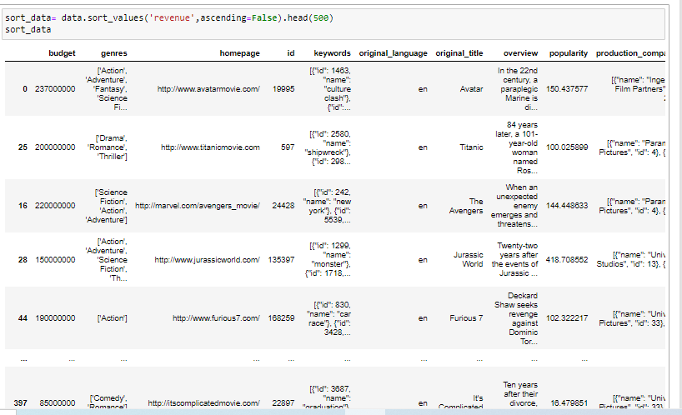
Task 10:- Sort the data in descending order based on revenue and filter the to 500 movies. Find the measures of central tendency of the following columns using the filtered data. 1) Budget 2) Revenue 3) Runtime Perform outlier analysis for the above three columns using box plots.
In this task, first we sort the data with the help of the revenue by descending order.
We assign variables to sorted data
After sorting we set a limit for 500 columns only.

Slide 18
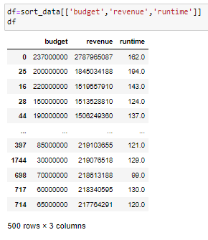
Task 10 (contd.)
In this task, we select the budget, revenue, and runtime columns for further calculations.
We assign variable ‘df’ for this data

Slide 19
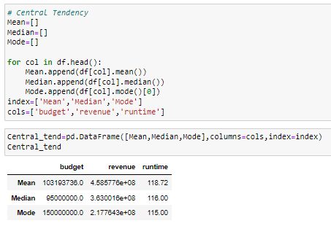
Task 10 (contd.)
In this task, we find the central tendency of the sorted data
In central tendency there are mainly calculated three things which are Mean, Mode, and Median.
This process is repeated for three columns. We define a function for it.
After calling the function we got the output for all the columns.

Slide 20
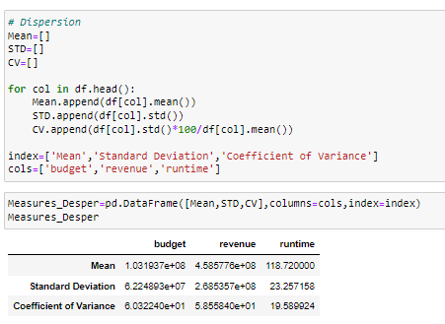
Task 10 (contd.)
In this task, we find the Dispersion of the sorted data
In Dispersion there are mainly calculated three things which are Mean, Standard deviation, and Coefficient of variance.
This process is repeated for three columns. We define a function for it.
After calling the function we got the output for all the columns.

Slide 21
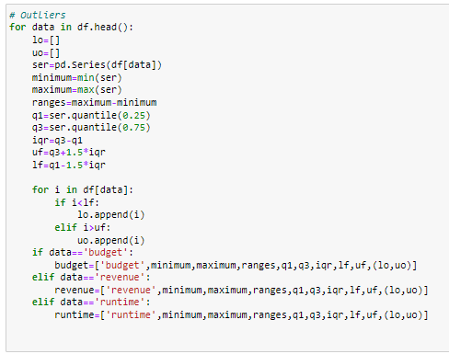
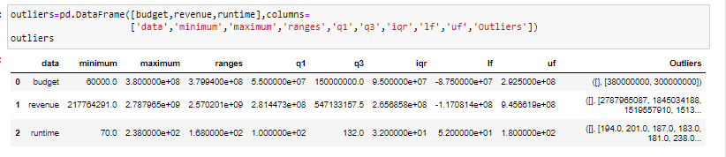
Task 10 (contd.)
In this task, we find the outliers in the data
In Dispersion there are mainly calculated few things which are the Upper Fence, Lower Fence, First Quartile, Third Quartile, Inter-quartile range(IQR), and Outliers.
This process is repeated for three columns. We define a function for it.
After calling the function we got the outliers for all the columns.

Slide 22
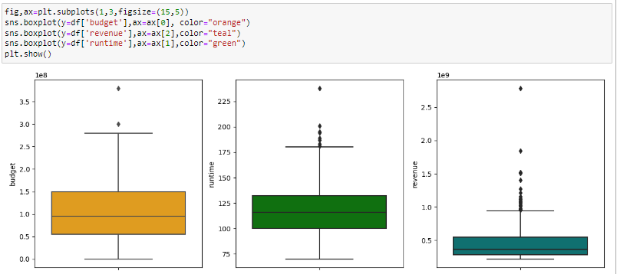
Task 10 (contd.)
In this task, we visualize the boxplot for each of the columns.
first we convert the data into the list.
We use the seaborn to visualize the boxplot.

Slide 23
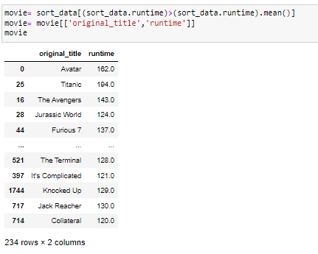
Task 11:- Identify and display the names of the movies along with their run times for those movies that have above-average runtime, using the data from the previous task
The Titanic movie has the highest runtime in the Data set.
We got a total of 234 rows of movies whose runtime is greater than the average runtime.

Slide 24
Conclusion
As per the analysis, there are positive responses from the people for new movies.
also preferred for reality-based, action movies and sci-fi movies.
As per correlation there are weak positive correlations between popularity and budget.
The Paramount Pictures production house has generated large amounts of movies.

Slide 25
THANK YOU
Sanket Bhosale

